Slide 1
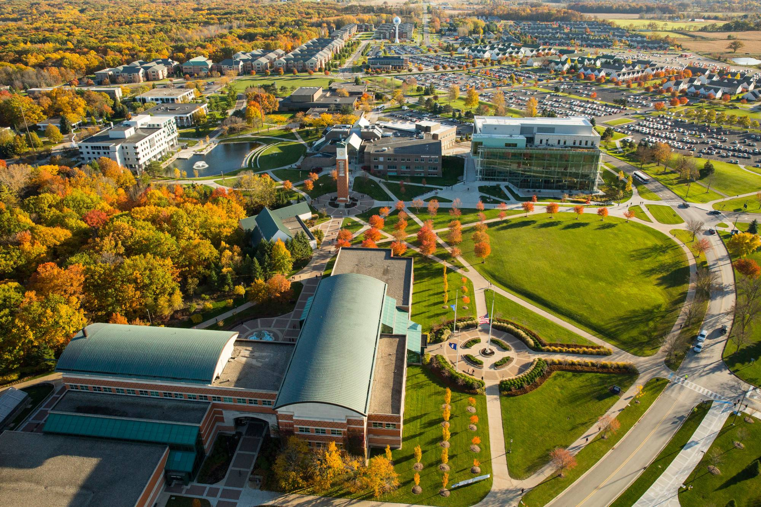

AI Benchmarks CCSC-MW Fall 2024 Conference Tutorial
Bill Nicholson
Assistant Professor Educator
Information Systems Program
Lindner College of Business
University of Cincinnati
nicholdw@ucmail.uc.edu
https://github.com/nicomp42/CCSCMW2024

Slide 2
Our focus today
Motivation for studying AI benchmarks
General overview of some benchmarks
Analyze benchmark contents with Python
Questions

Slide 3
How do we characterize an AI model?
Anecdotally:
https://www.namepepper.com/chatgpt-users#exam-stats (totally random and unsubstantiated source)

Slide 4
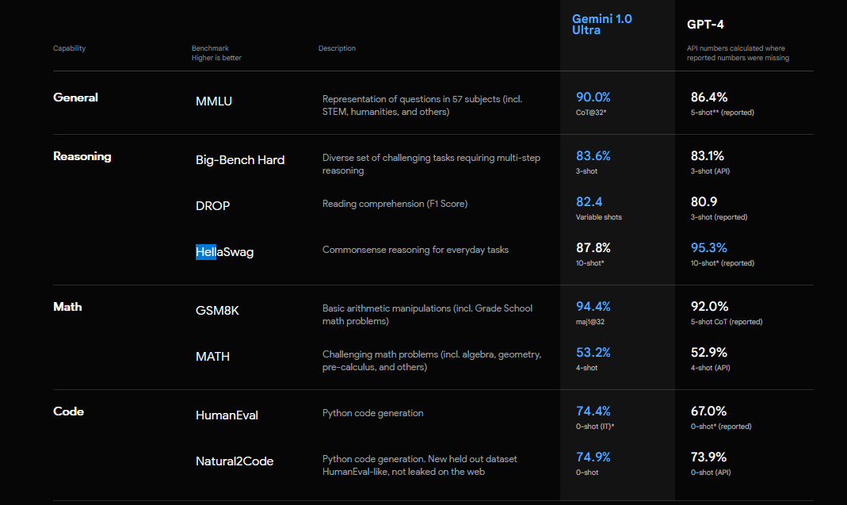
Leaderboard : Google Gemini vs GPT-4
https://deepmind.google/technologies/gemini/#introduction

Slide 5
General overview of our benchmarks
Appearing in AI Leaderboards
Open Source and human-readable data files
Supported by published research
OpenAI, Allen Institute, U Chicago, Stanford, more
Content generated by AI, humans, Internet

Slide 6
Benchmarks processed today
Big-Bench Hard: humans outperforming LLMs
FamRel: family relations
HellaSwag: context completion
ARC-Challenge: science
TruthfulQA: human misconceptions

Slide 7
Big-Bench Hard Benchmark
“Questions wherein humans outperformed LLMs ”
6761 questions spanning 23 categories
Google Research, Stanford University
[1]
https://github.com/suzgunmirac/BIG-Bench-Hard/blob/main/bbh/README.md

Slide 8
Some Categories
Logic
Sarcasm
Word Problems
Navigation
Snark
Penguins in a Table
Movie Recommendation
Big-Bench Hard Benchmark

Slide 9
Category : Penguins in a table
Here is a table where the first line is a header and each subsequent line is a penguin: name, age, height (cm), weight (kg) Louis, 7, 50, 11 Bernard, 5, 80, 13 Vincent, 9, 60, 11 Gwen, 8, 70, 15 For example: the age of Louis is 7, the weight of Gwen is 15 kg, the height of Bernard is 80 cm. We then delete the penguin named Bernard from the table.
How many penguins are less than 8 years old and weight less than 12 kg?
Big-Bench Hard Benchmark

Slide 10
Category : Penguins in a table (reformatted for humans)
Here is a table where the first line is a header
and each subsequent line is a penguin:
For example: the age of Louis is 7, the weight of Gwen is 15 kg, the height of Bernard is 80 cm. We then delete the penguin named Bernard from the table.
How many penguins are less than 8 years old and weight less than 12 kg?
name | age | height(cm) | weight(kg)
Louis | 7 | 50 | 11
Bernard | 5 | 80 | 13
Vincent | 9 | 60 | 11
Gwen | 8 | 70 | 15
One
Big-Bench Hard Benchmark

Slide 11
Previous question and correct answer
“How many penguins are less than 8 years old and weight less than 12 kg?”
One
Big-Bench Hard Benchmark

Slide 12
The data in this benchmark is JSON
{"input": "Here is a table where the first line is a header and each subsequent line is a penguin: name, age, height (cm), weight (kg) Louis, 7, 50, 11 Bernard, 5, 80, 13 Vincent, 9, 60, 11 Gwen, 8, 70, 15 For example: the age of Louis is 7, the weight of Gwen is 15 kg, the height of Bernard is 80 cm. We now add a penguin to the table:\nJames, 12, 90, 12\nHow many penguins are less than 8 years old and weight less than 12 kg?\nOptions:\n(A) 1\n(B) 2\n(C) 3\n(D) 4\n(E) 5",
"target": "(A)"},
Big-Bench Hard Benchmark

Slide 13
Analysis Strategy
Obtain the corpus of questions
Load the questions into a list of dictionaries and a big text string.
Perform analysis
Select a random question
Compute readability indices
Build a word cloud
Compute word frequencies
Compute longest words
Find words not in the dictionary

Slide 14
We don’t care about
Validity of questions*
The correct answers
* https://www.surgehq.ai/blog/hellaswag-or-hellabad-36-of-this-popular-llm-benchmark-contains-errors

Slide 15
Our Software Architecture
Jupyter Notebooks
Each benchmark has an entry point module: Main {benchmark}.ipynb
Each benchmark has a directory structure
A folder with the benchmark name, containing
Questions in a folder called data
Results in a folder called results

Slide 16
Consuming questions in different formats, from different sources.
In our code, we end up with:
A dictionary called questions with 2 keys:
Key “input”-> the text of the question
Key “target” -> the text of the possible answers
A humongous string called text
All the questions and answers appended together.
Some cleanup, but not much.

Slide 17
Build your own benchmark processor
Create the directory structure
Add a processor class to load the original question data
Json_Processor.ipynb, or
CSV_Processor.ipynb
Start with a copy of Main Template.ipynb
Follow the “ToDo”s in that notebook
Run the notebook, look in the results folder

Slide 18
Future Work
Filter out common words prior to analysis
See function build_text_from_questions
Implement Sentiment Analysis
Read up on Word Clouds (what value do they provide?)
Investigate the impact on leaderboards from subtle changes to the questions.
Investigate grammar issues in questions

Slide 19
Questions?

